Slide 1
Srinivas Rao PrithviNag Kolla
INFO 5709 Fall 2020
Final Project

Slide 2
US 2020 ELECTION SENTIMENT ANALYSIS
Forecasting the Presidential Elections has become a trend in Academia. Recently, US 2020 Elections were held, and Joe Biden was declared the winner. I wanted to know if this can be predicted from the twitter data before the election results were declared. The main contestants were Joe Biden from Democratic party and Donald Trump from Republican Party. I wanted to do Sentiment Analysis on Twitter data to get results of who will be the possible winner of US 2020 Elections.

Slide 3
Problem
Is Trump liked more or Biden?
Is Trump or Biden, who is more popular in India?
How are the sentiments for each leader among the people?

Slide 4
Motivation
In last decade, there was a steady increase in data mining and finding out the opinions in text data very much. This particular opinion data from Twitter is used for stock market prediction and also for analyzing Social movements across United states and many other countries. Tumasjan (2010) found tweet volume about the political parties to be a good predictor for the outcome of the 2009 German election, while Choy et al. (2011) failed to predict with Twitter sentiment the ranking of the four candidates in Singapore’s 2011 presidential election. Now, I am using data from Kaggle, which has lots of Noise in it like Punctuation, Symbols, Uppercase letters, Stop words, numbers and links. This will be a challenge for me.

Slide 5
Data Set and Dictionary
tweet_id: Unique ID of the tweet
tweet: Full tweet text
likes: Number of likes
retweet_count: Number of retweets
source: Utility used to post tweet
user_id: User ID of tweet creator
user_name: Username of tweet creator
user_screen_name: Screen name of tweet creator
user_description: Description of self by tweet creator
user_join_date: Join date of tweet creator
user_followers_count: Followers count on tweet creator
user_location: Location given on tweet creator's profile
lat: Latitude parsed from user_location
long: Longitude parsed from user_location
city: City parsed from user_location
country: Country parsed from user_location
state: State parsed from user_location
state_code: State code parsed from user_location
collected_at: Date and time tweet data was mined from twitter
created_at: Date and time of tweet creation

Slide 6
Data Cleaning and Transformation
Since I am performing Sentiment Analysis, I had to clean tweets having noise like Punctuation, Symbols, Uppercase letters, Stop words, numbers and links. I used regular expression to clear them. I used Pandas and NumPy for cleaning and Transformation like dropping the columns not used for analysis. For visualization, I used Matplotlib and Plotly. For sentiment Analysis, I used NLTK and Textblob packages. The redundant process were placed in functions. Concat method was used to merge two dataframes. Counter was imported to count the polarity values like positive, negative and neutral sentiments.

Slide 7
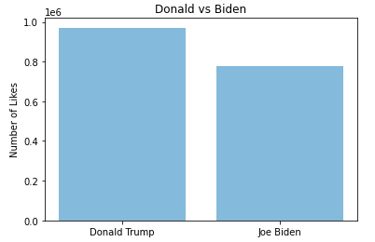
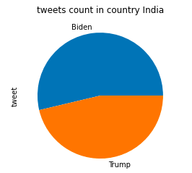
Data Analysis

Slide 8
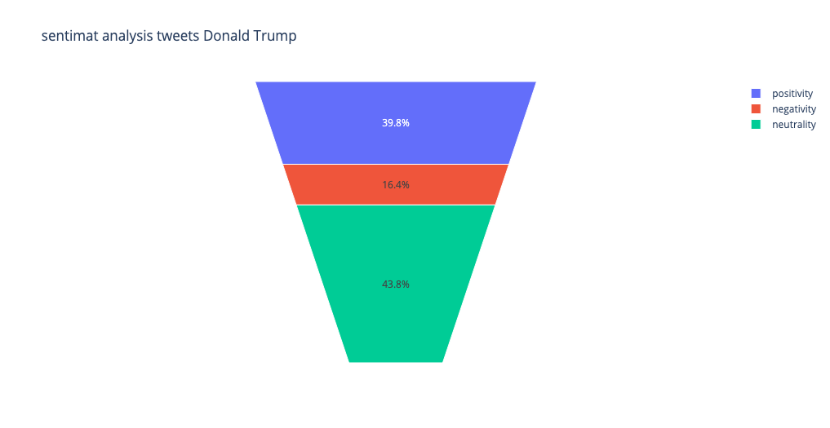

Data Analysis

Slide 9
Future Work
We should have ideally same number of tweets from all the states, well that is quite impossible to have, but we can try by Distributing the data Uniformly. We can also use Supervised and Un Supervised Machine Learning Algorithms to predict the sentiments with better accuracies. We can also use Term Frequency – Inverse Document Frequency to increase the accuracy of Prediction.

Slide 10
Conclusion
From the Visualizations people can infer that Donald Trump has more likes than his counterpart from the bar chart. The Pie chart tells that In India, there was more discussion about Joe Biden than Donald Trump. From Sentiment Analysis, through funnel area graph chart we found that Donald Trump has fewer positive sentiments and more negative sentiments in the tweets than Joe Biden. We found out that Joe Biden has more chance of winning the US 2020 Election even though the data had more likes for Donald Trump. Which is True as Biden won in the 2020 US Elections.

Slide 11
References
Wang, Hao, et al. A System for Real-Time Twitter Sentiment Analysis of 2012 U.S. Presidential Election Cycle.
Gukanesh, A. V., Kumar, G. K., & Saranya, K. K. R. K. | N. (2018). Twitter Data Analytics – Sentiment Analysis of An Election. International Journal of Trend in Scientific Research and Development,Volume-2(Issue-3),1600–1603. https://doi.org/10.31142/ijtsrd11457
KA, A. (2020, November 12). Data Visualization: US Election 2020. Retrieved from Medium website: https://medium.com/swlh/data-visualization-us-election-2020-a3d3531b611c

Slide 12
Thank You

